Slide 1

Team Black Homecoming
Econometrics Team Presentation
OKCupid Public Dataset (2015)
15th July 2019

Slide 2
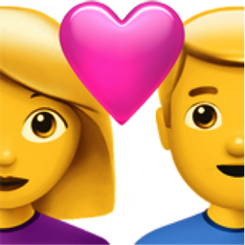
Contents
Approach
Dataset
Aims
Method
Results
Average user
Most-likely to swear
Next steps / improvements

Slide 3
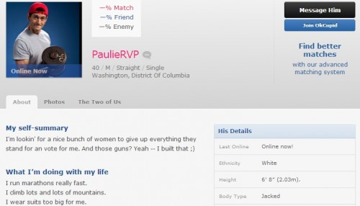
Dataset – OKCupid Profiles

Slide 4
Dataset – OKCupid Profiles
59946 observations of 22 variables
Variables:
Age (int.)
Body type (categorical variable)
Diet (categorical variable)
Drinks (categorical variable)
Drugs (categorical variable)
Education (categorical variable)
Ethnicity (multiple categorical variable)
Height (int.)
Income (int.)
Job (multiple categorical variable)
Location (multiple categorical variable)
Offspring (multiple categorical variable)
Orientation (categorical variable)
Pets (multiple variable)
Religion (multiple categorical variable)
Sex (categorical variable)
Smokes (categorical variable)
Status (categorical variable)
Speaks [language] (multiple categorical variable)
Ethnicity (multiple categorical variable)
Sign [Star Sign] (multiple categorical variable)
Essay (string) [only first 140 characters]

Slide 5

Aims
What are the most common traits of an OKCupid user?
Which type of users are most likely to use swear words in their profile ‘essay’?
Are there any clusters in the data?

Slide 6
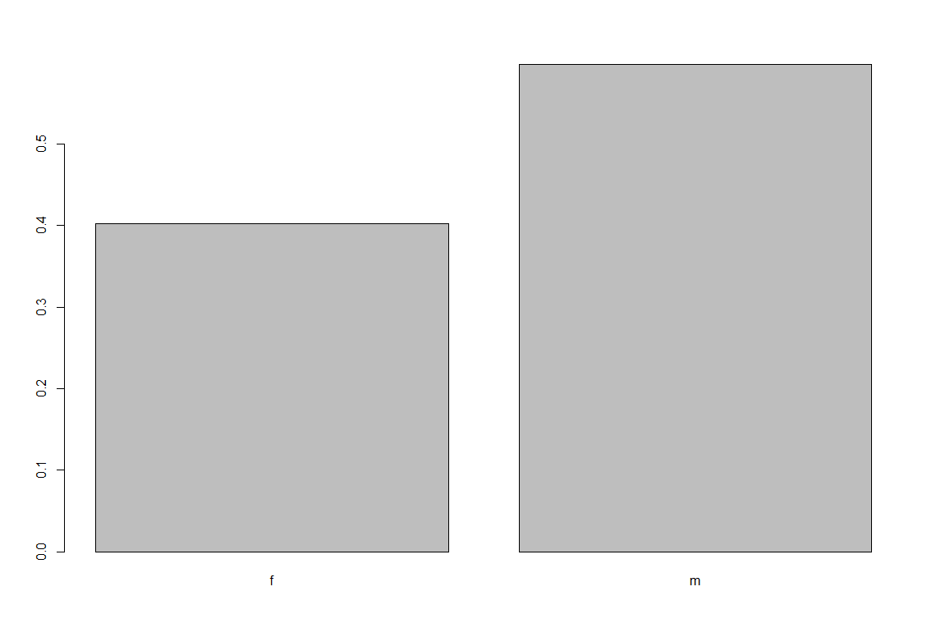
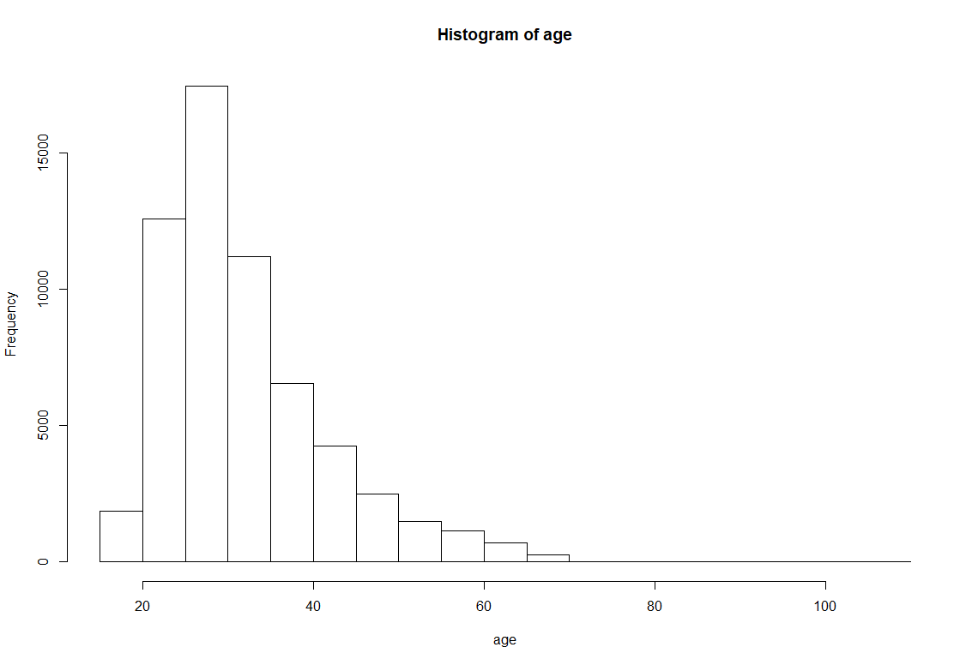
Method – Average User
Looked at structure & summary
Explored individual variables & their relation to one another:

Slide 7
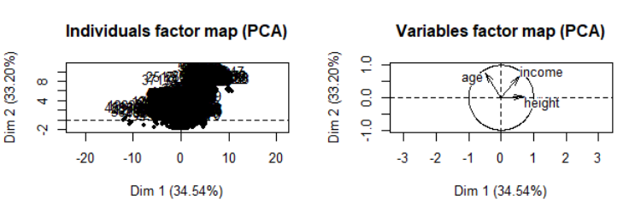
Method – Average User
Split the data into categorical & numerical data.
Removed NA’s – more accurate to remove than to use median or guess a categorical answer. Given the size of the dataset the analysis would not be affected by this action
Ran PCA of the numerical values:

Slide 8
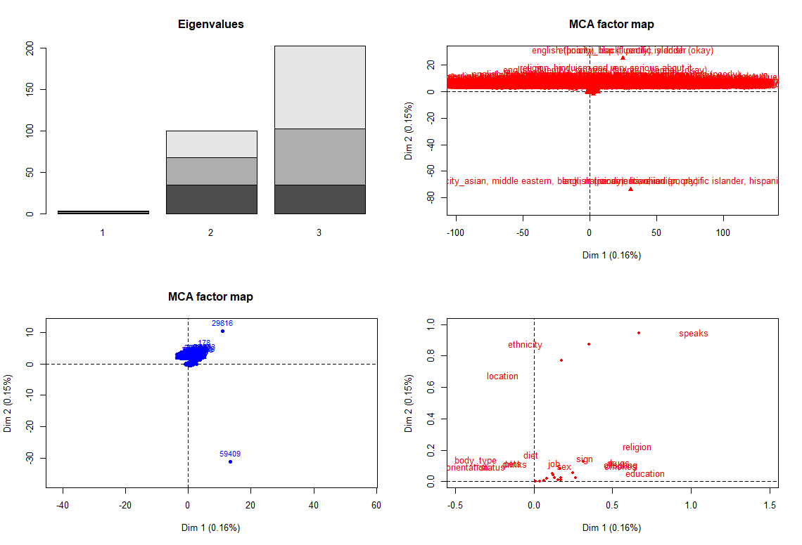
Method – Average User
MCA analysis for the categorical values (using Cleaned Data):

Slide 9
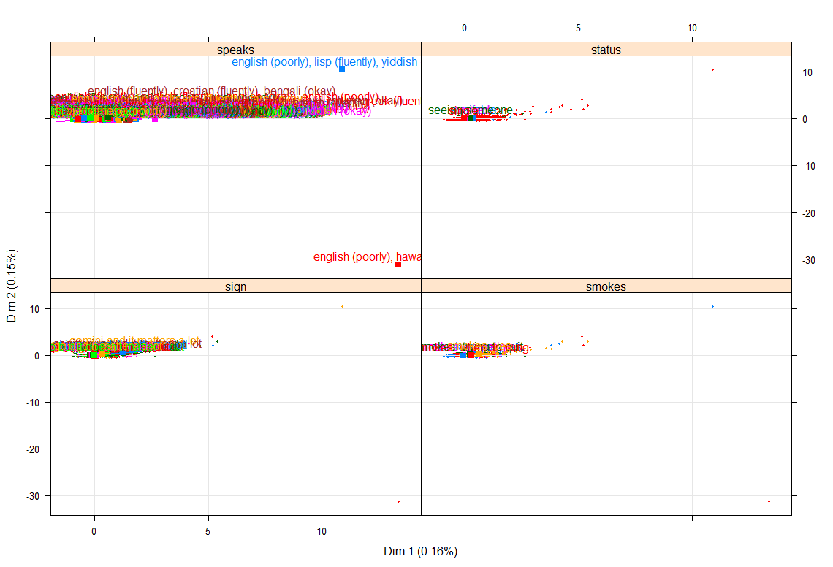
Method – Average User

Slide 10
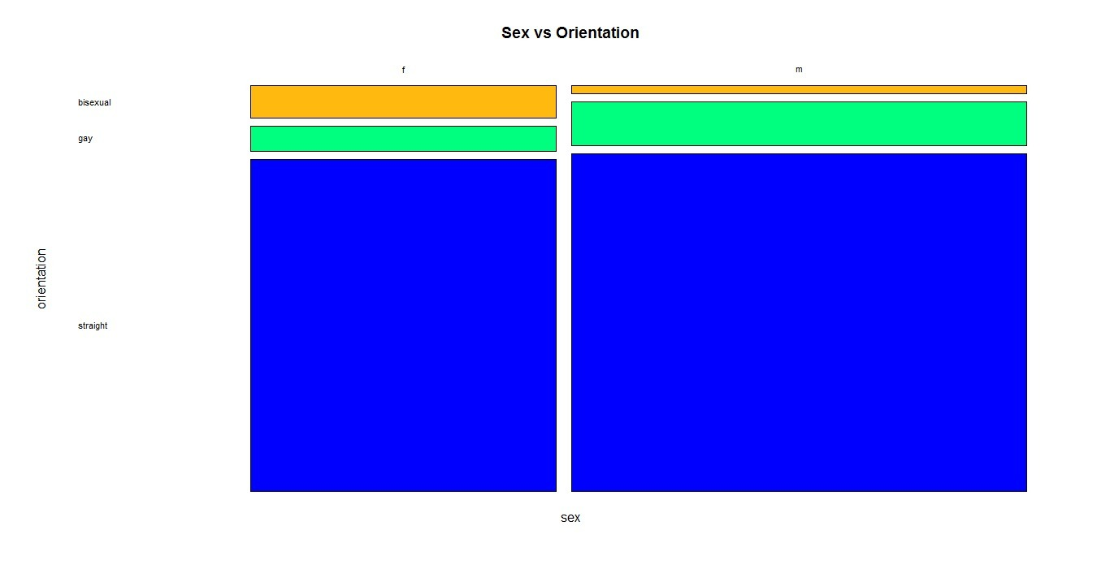
Method – Average User
Exploring sexuality vs. gender:

Slide 11
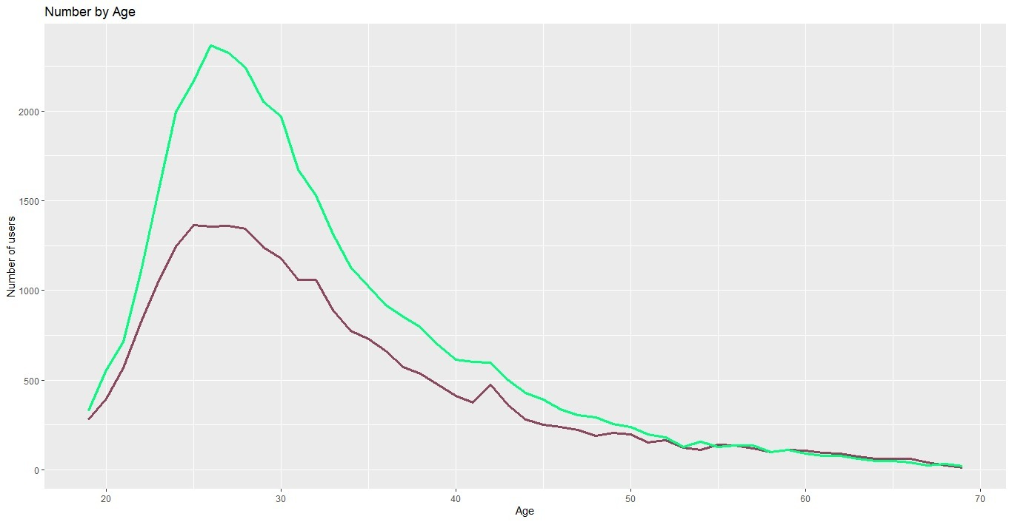
Method – Average User
Exploring age vs. gender:

Slide 12
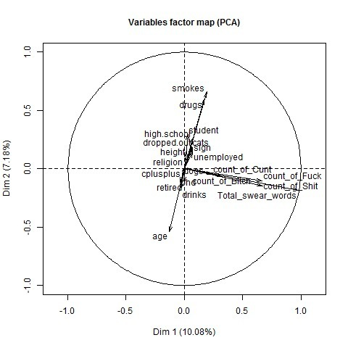
Method – Average User
Correlations between variables:

Slide 13
Method - Swear Words
Preparing the Dataset
Split out and count the number of swear words in the ‘essay’ column
For this we only focused on four swear words (Fu**, Cu**, Bi***, Sh**)
There are 371 instances of swear words across the data set
Reduce the dataset to a sub-set where count of swear words >0
There are 350 accounts which feature swearing
Some accounts contain more than 1 swear word, with a max of 4 recognised words in a single essay of 140 characters

Slide 14
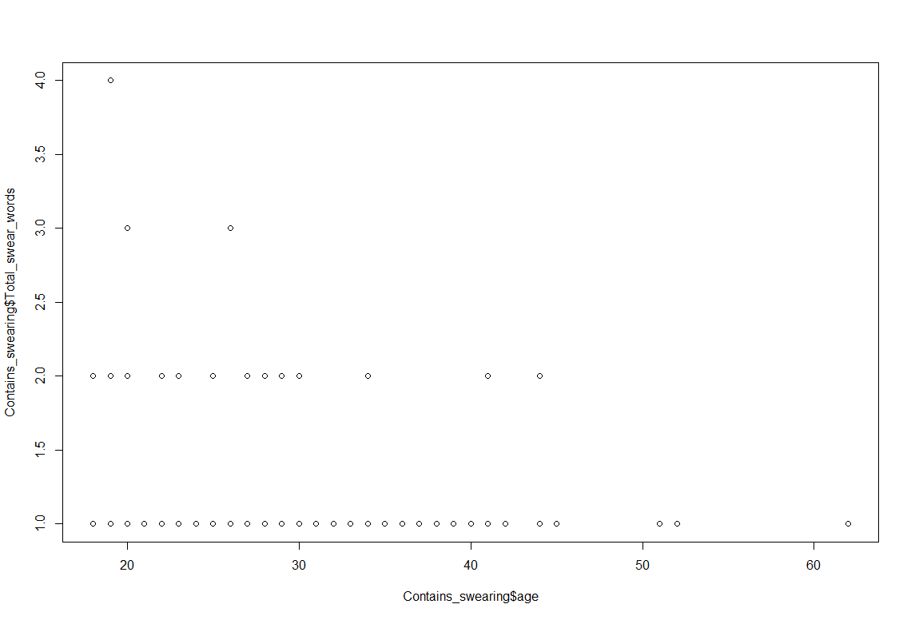
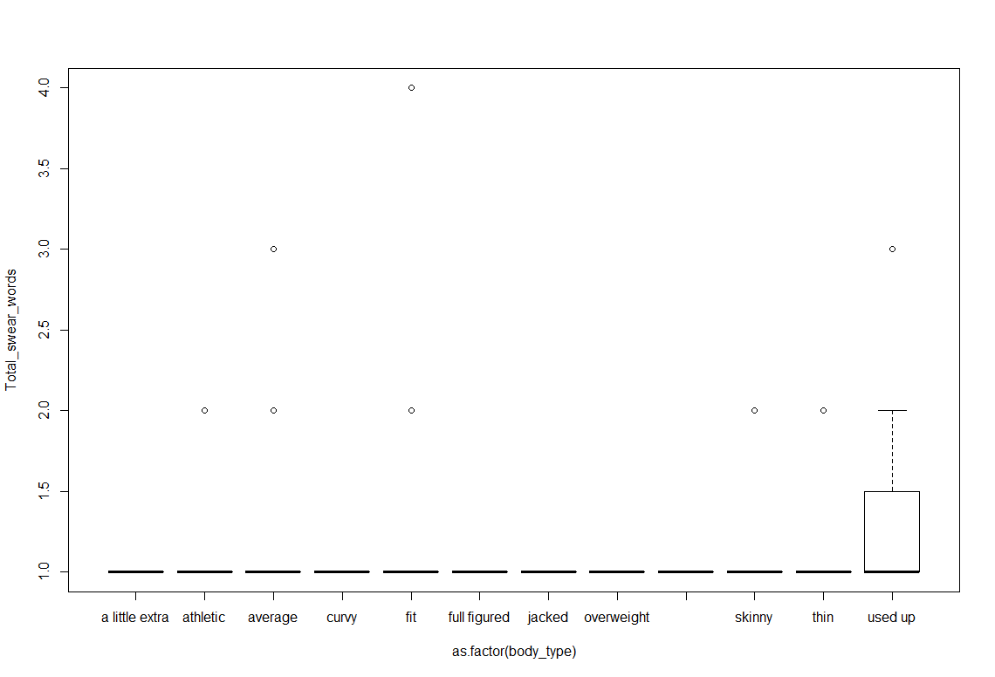
Method - Swear Words
Exploring the dataset
Plotted each variable against count of swear words to see which variables indicated a pattern (e.g. age, body type)

Slide 15
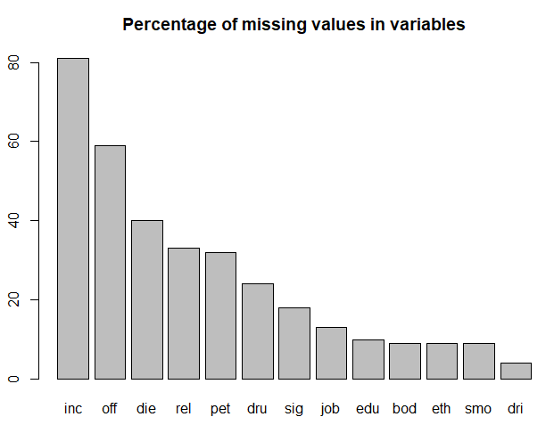
Method – Swear Words
Cleaning the Dataset
Missing Values
Removed the rows which didn’t have any data in the ‘essay’ column
Looked at how many observations were missing values for each variable
Removed all the variables with more than 40% missing values – Income, Offspring, Diet
Removed ‘last online’, ‘location’ and ‘status’ as these were either not interesting or too similar to feed into the analysis

Slide 16
Cleaning Data
PETS
BODY TYPE
Before: char, 16 unique values
After: 2 binary variables (dogs, cats)
Assumed that dog/cat owners like them
Before: char, 13 unique values
After: aggregated body types to 7 levels, convert to categorical variable

Slide 17
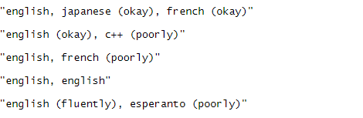
Cleaning Data
DRINKS, DRUGS, SMOKES
SPEAKS
Before: character variables
Drinks: not at all, rarely, socially, often, very often, desperately
Drugs: never, sometimes, often
Smokes: multiple options
After: Drugs, drinks – numerical with range, smokes - binary
Before: char, 7253 unique values
After: 3 binary variables
English
Numer of languages spoken
C++

Slide 18
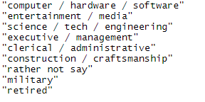
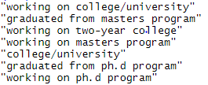
Cleaning Data
EDUCATION
JOB
Before: char, 33 unique values
After: aggregated to 3 binary:
High school
Dropped out
PhD
Before: char, 22 unique values
After: aggregated to 3 binary:
Student
Retired
Unemployed

Slide 19



Cleaning Data
RELIGION and SIGN
ETHNICITY
Before: 46 and 49 unique values
After: 2 binary variables only for those who are serious about it
Before: char, 206 unique vars
After: dropped from the analysis

Slide 20
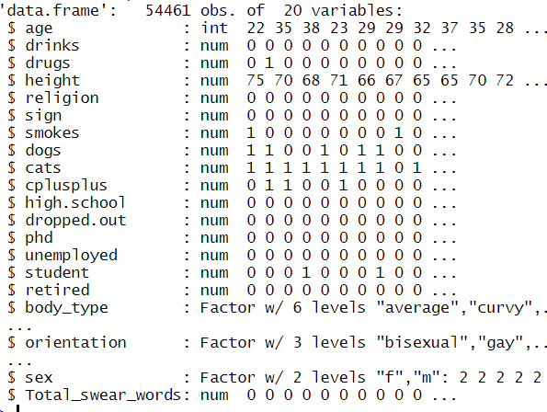
Final Dataset

Slide 21
Method - Swear Words
Identifying a Regression Model
Initially looked at a model including all variables and feeding this into the Step() function
R-squared for the Step() is very low (0.0058) ~ regression model not a good fit for the data
However the step model did identify significant factors:

Slide 22
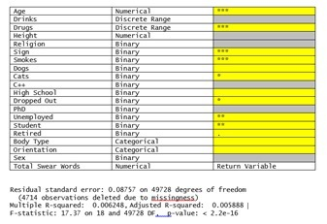
Method - Swear Words

Slide 23
Method - Finding clusters in the data
Supervised clustering
Four different types of supervised clustering were attempted
Attempted to cluster by swear words(binary), orientation, unemployment, but these didn’t produce any viable results
Clustering by gender produced more meaningful results:
Ran on a smaller dataset due to size of the dataset crashing the laptop
Used Caret to reduce the dataset
Whilst we obtained better results for these samples, the k-means method is still not accurately predicting males
 | 1 | 2
F | 2923 | 1097
M | 4615 | 1365

Slide 24
Results – Average User
More male than female
Most likely straight
Most likely in late twenties to early thirties
Most likely white ethnicity
Around 1.77m height
Most likely does not take drugs
Most likely does drink socially
Interesting points:
Drug taking increases as drinking increases
Very small number of men identifying as bi-sexual compared to women
After 60 years old, the number of women on OK Cupid surpasses the number of men

Slide 25
Results – Clustering & Swear Words
Clustering
Clustering method gave limited results. K-means was not successful at finding clusters for swear words(binary), orientation, unemployment.
Clustering by gender produced improved but limited results
Swear Words
Regression model is not a good fit for the data
Step() model did identify factors which are more significant than others include age, drugs, star sign and smoking.

Slide 26
Interesting things/ things to explore
Height has a closer correlation to income than age ~ needs more investigation to verify this
User age has a second peak around mid-40s for both male and female ~ is there a way we can analyse this subgroup’s essays to understand their motivations for using the service?
If we had more than 140 characters of the essay, would we find any more instances of swearing?

